Slide 1
Transformation
2D

Slide 2

2D Rotation
Rotation about origin (cont.)
Equation in matrix form
P = Original position
P’ = R • P P’ = New position
R = Rotation vector
Where rotation matrix is

Slide 3
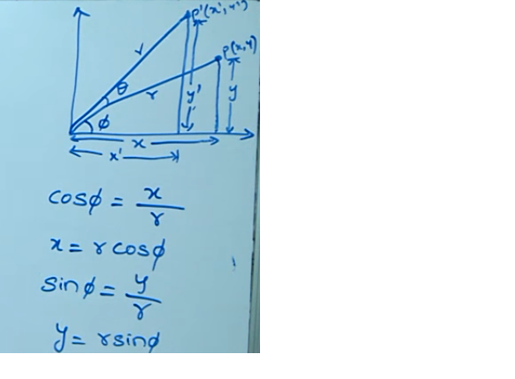
Anti-Clockwise Rotation

Slide 4
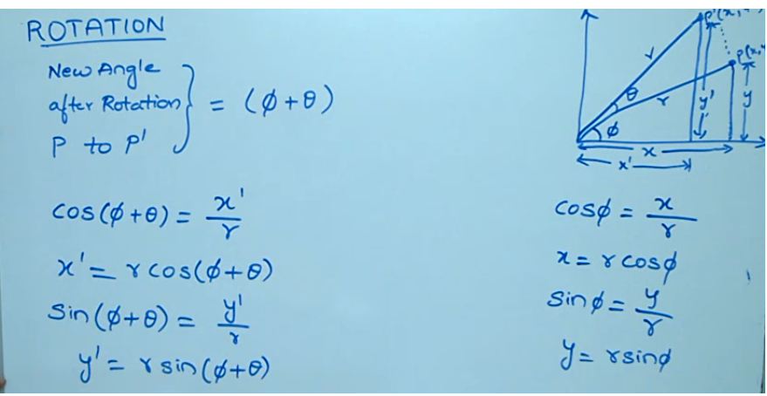

Slide 5
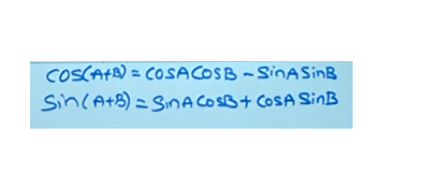

Slide 6
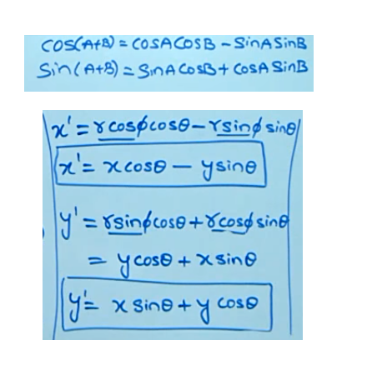

Slide 7
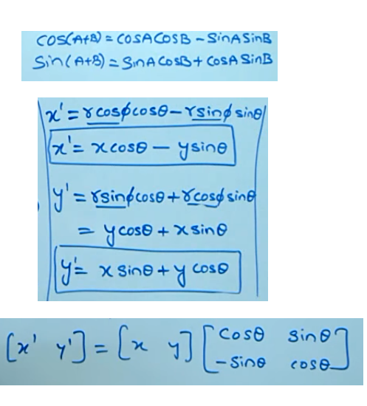

Slide 8
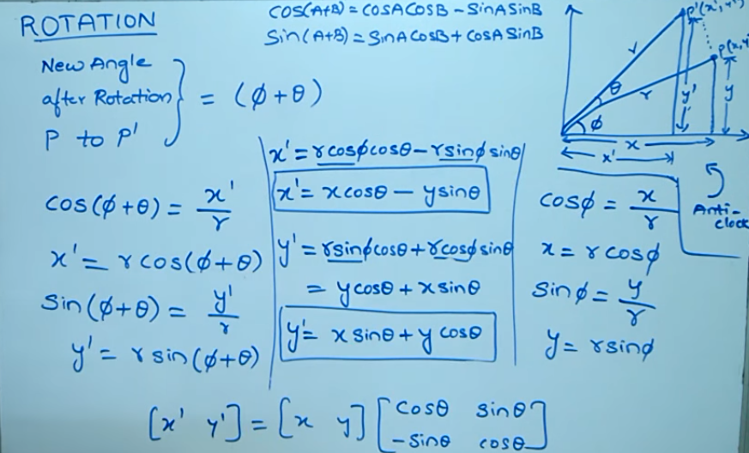

Slide 9
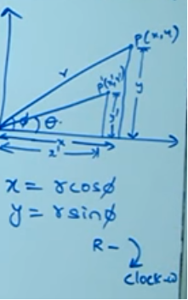
Clockwise Rotation

Slide 10
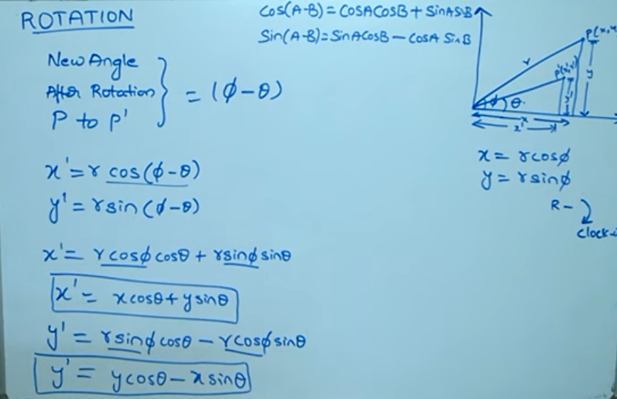

Slide 11
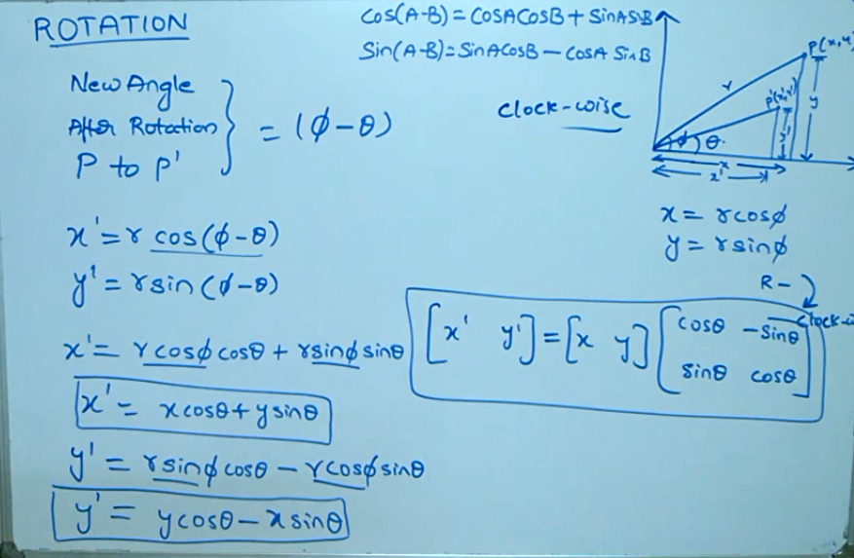

Slide 12
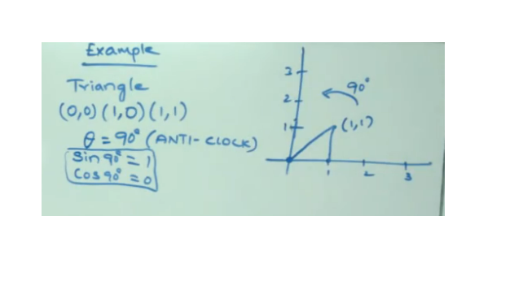
Problem Given

Slide 13
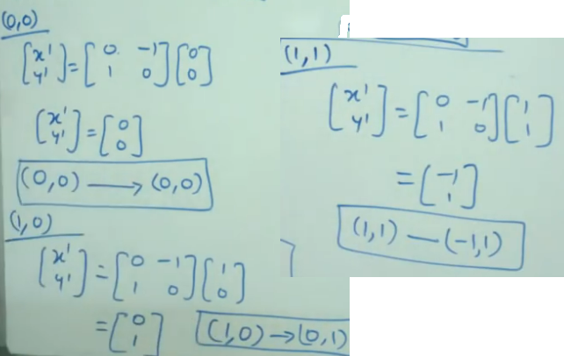

Slide 14
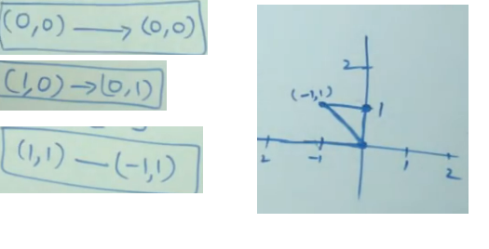
Finally

